Slide 1
Interview Trainer Agent
CAPSTONE PROJECT
Presented By:
ASTINA DAHIWALE
K.J. SOMAIYA COLLEGE OF ENGINEERING
INFORMATION TECHNOLOGY (INFORMATION SECURITY)

Slide 2
OUTLINE
Problem Statement
Proposed System/Solution
System Development Approach (Technology Used)
Algorithm & Deployment
Result (Output Image)
Conclusion
Future Scope
References

Slide 3
Problem Statement
Job seekers and freshers often struggle to prepare for interviews due to a lack of role-specific practice. General question banks lack personalization, which makes preparation inefficient. There is a strong need for an AI-driven system that generates targeted questions and model answers based on a user’s job role and experience level.

Slide 4
Proposed Solution
The Interview Trainer Agent, built using Agentic AI on IBM Watsonx, dynamically generates role-specific interview questions and model answers for all supported job roles and experience levels. The implemented system:
Accepts inputs via a guided AI-powered conversation.
Uses Agentic AI reasoning to determine relevant technical and behavioral questions.
Delivers model answers to enhance preparation quality.
Covers multiple roles such as Software Engineer, Data Analyst, and Product Manager, each with Beginner, Intermediate, and Advanced levels.
Provides instant, interactive results for every role–level combination.

Slide 5
System Development Approach (Technology Used)
Platform: IBM Watsonx Assistant with Agentic AI capabilities.
Agent Design: Modular skills for each role–level pair, ensuring results for all 9 combinations.
Logic Flow: Agent dynamically selects the appropriate question set based on inputs.
Output Handling: Structured JSON-like responses with conversational AI text.
Testing: Verified for all role–level combinations, producing consistent, targeted outputs.

Slide 6
Algorithm & Deployment
Algorithm (Agentic AI Workflow):
Input Capture: User selects job_role and experience_level.
Agentic Reasoning: AI chooses the matching question–answer set from the knowledge base.
Response Generation: Questions and model answers displayed conversationally.
Deployment:
Hosted entirely on IBM Watsonx Agentic AI environment.
No separate backend coding required.
Successfully tested for 3 roles × 3 levels = 9 unique outputs, all functioning correctly.

Slide 7
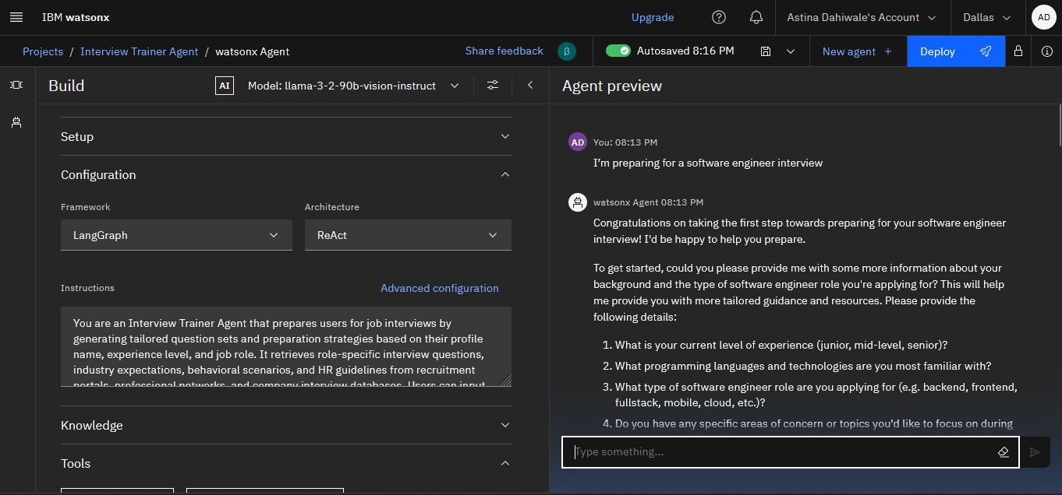
Result

Slide 8
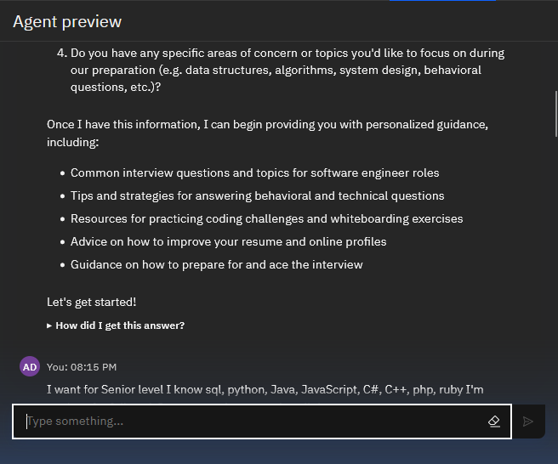
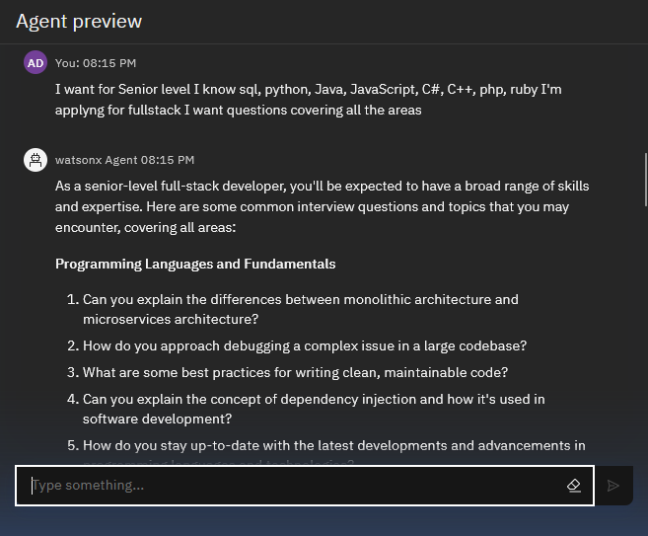
Result

Slide 9
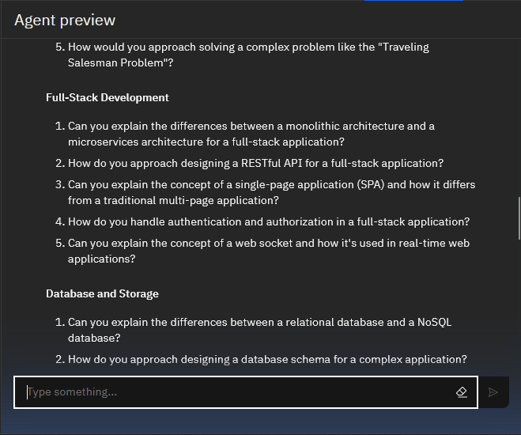
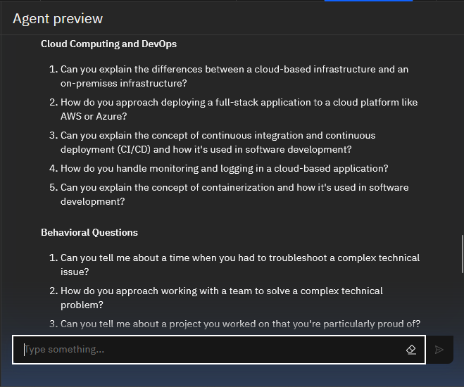
Result

Slide 10
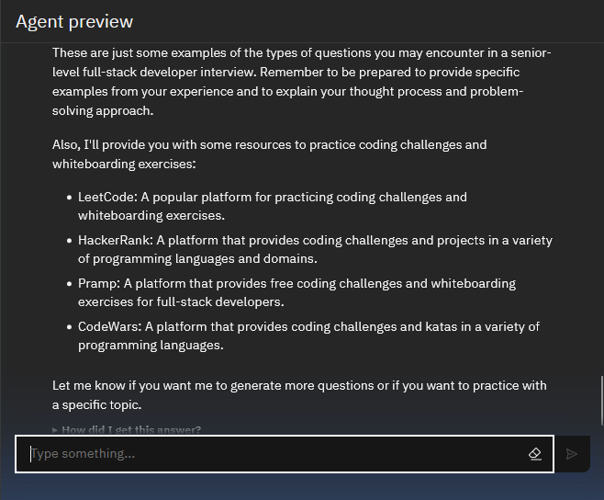
Result

Slide 11
Conclusion
The Interview Trainer Agent delivers personalized interview simulations for every job role and level combination tested. Agentic AI enables context-aware, scalable, and adaptable training without complex manual coding. The complete coverage across roles and levels ensures all users receive relevant and targeted preparation.

Slide 12
Future scope
Dynamic Content Retrieval: Integrate with IBM Watson Discovery or Watsonx RAG API to fetch up-to-date role-specific questions.
Speech-Based Simulation: Enable voice-based interview practice with real-time conversation flow.
AI-Driven Feedback: Provide instant scoring and improvement suggestions using sentiment and tone analysis.
Specialized Domain Expansion: Add niche fields like cybersecurity, cloud computing, and finance.
Multi-Language Support: Offer interview preparation in multiple languages for wider reach.
Scalable Role Coverage: Extend beyond the current 3 roles × 3 levels to an unlimited number of job–level combinations.

Slide 13
References
IBM Watsonx Assistant & Agentic AI Documentation – https://cloud.ibm.com/docs/watsonx
IBM Cloud Documentation – https://cloud.ibm.com/docs
IBM Agentic AI Overview – https://research.ibm.com/agentic-ai
IBM Watson Discovery Documentation – https://cloud.ibm.com/docs/discovery
RAG (Retrieval-Augmented Generation) Concept Overview – IBM Developer Portal

Slide 14
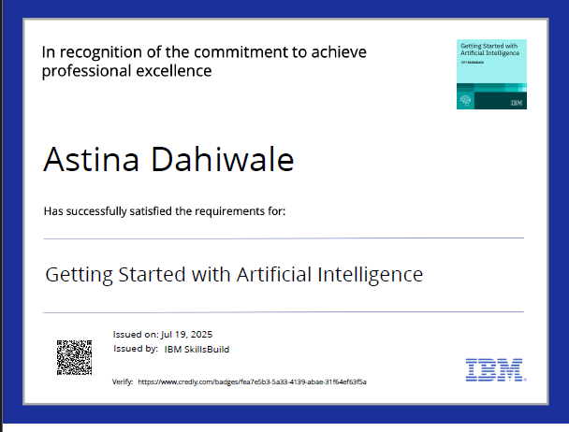
IBM Certifications

Slide 15
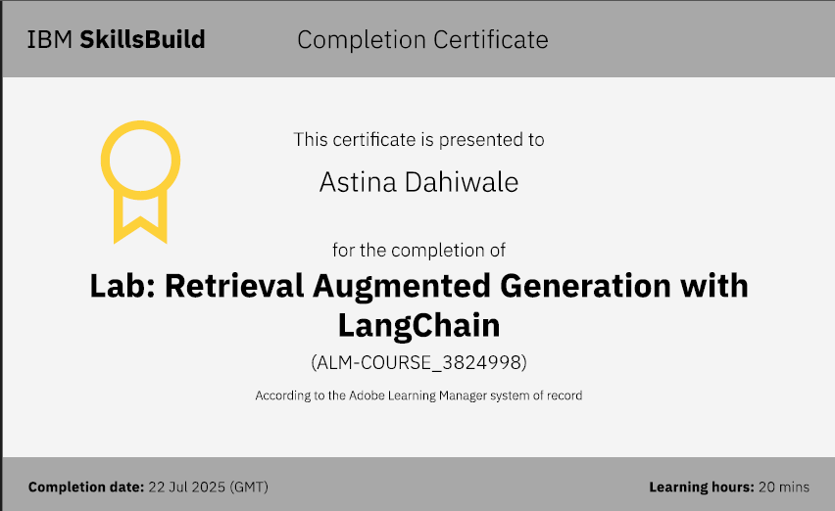
IBM Certifications

Slide 16
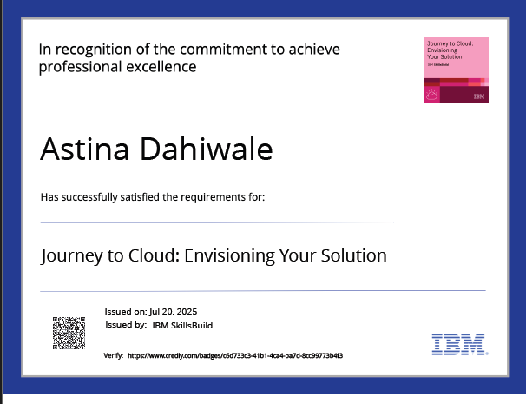
IBM Certifications

Slide 17
THANK YOU

